Slide 1
INVESTMENT CASE STUDY SUBMISSION
VAMSI KRISHNA GP
vkrishna84@gmail.com
ID - APFE18f00392

Slide 2
Spark Fund - Investment Analysis and Suggestion
Spark Funds wants to make investments in a few companies.
The CEO of Spark Funds wants to understand the global trends in investments so that she can take the investment decisions effectively.
Spark Funds has two minor constraints for investments:
It wants to invest between 5 to 15 million USD per round of investment
It wants to invest only in English-speaking countries because of the ease of communication with the companies it would invest in

Slide 3
Data Analysis
Input
Companies.txt
Has the details of each company such as Name, CompanyURL, Location, Unique Link for each company
From the data we can identify permalink is the index/unique identifier for the dataframe
Rounds2.csv
Has the details of funding for each company such as funding_type, funding_amount, company_permalink, raised_usd_amount, category
From the data we can idenify company_permalink is the unique identifier for the dataframe
Mapping.csv
There are several categories that companies fall into during investment. Mapping provides a way to further group all the sub-categories for easier analysis.

Slide 4
1. Map category to PrimarySector
2. Correct Spellings
Companies
Rounds2
Mapping
Filter Top 3 country
permalink to lowercase
company_permalink to lowercase
Clean Data
permalink
company_permalink
master_frame
(pd::join(left))
D1
D2
D3
master_frame
(pd::join(inner))
STOP, Nothing SUITABLE
Insuffcient Data
Not Found
Yes
Data Clean up
select Funding Type
Country with highest investment
Native Eng
Countries
No
Illustrations
master_frame
(clean)
1. Remove unnecessary Columns
2. Remove Duplicate values
3. Check if investment value > 0
Funding Value should lie
between 5 and 15 million

Slide 5
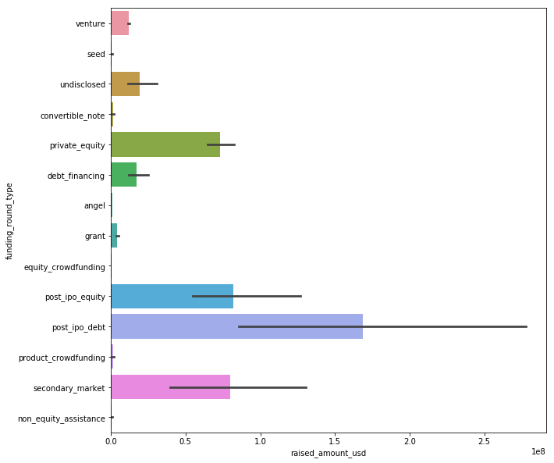
Total Funding
From the Graph, we can observe most of the investments in post-ipo and secondary market.
But our interest is towards Venture, Private-Equity, Seed and Angel Funds

Slide 6
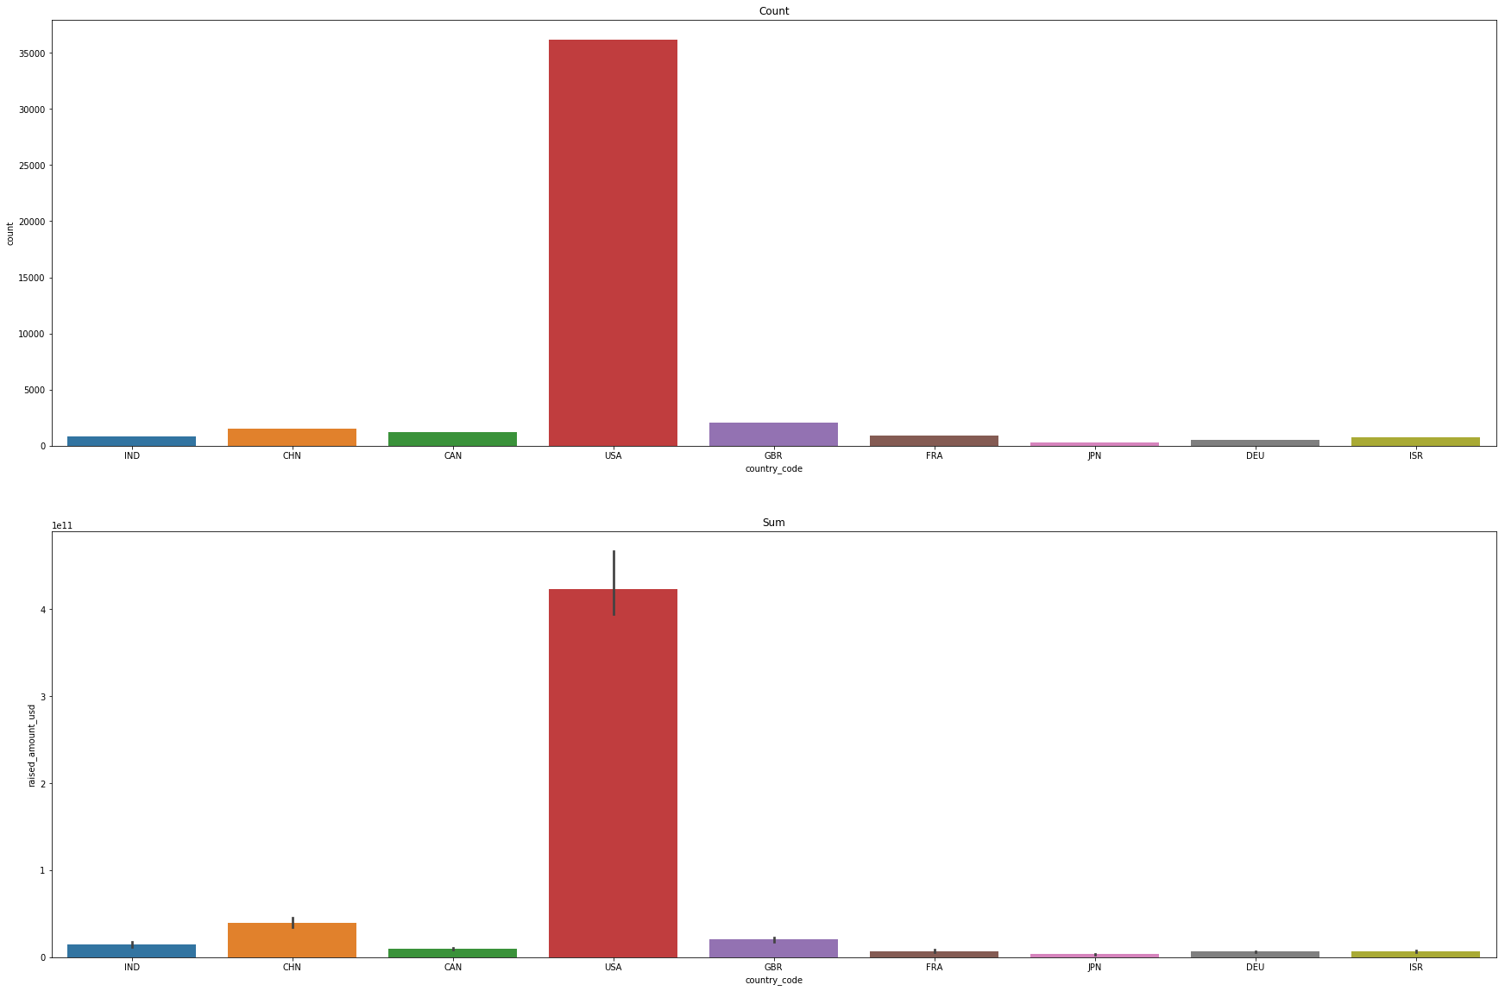
Investment Spread across countries
Observations
USA got highest number of investors and investments.
Its world leader in attracting investors

Slide 7
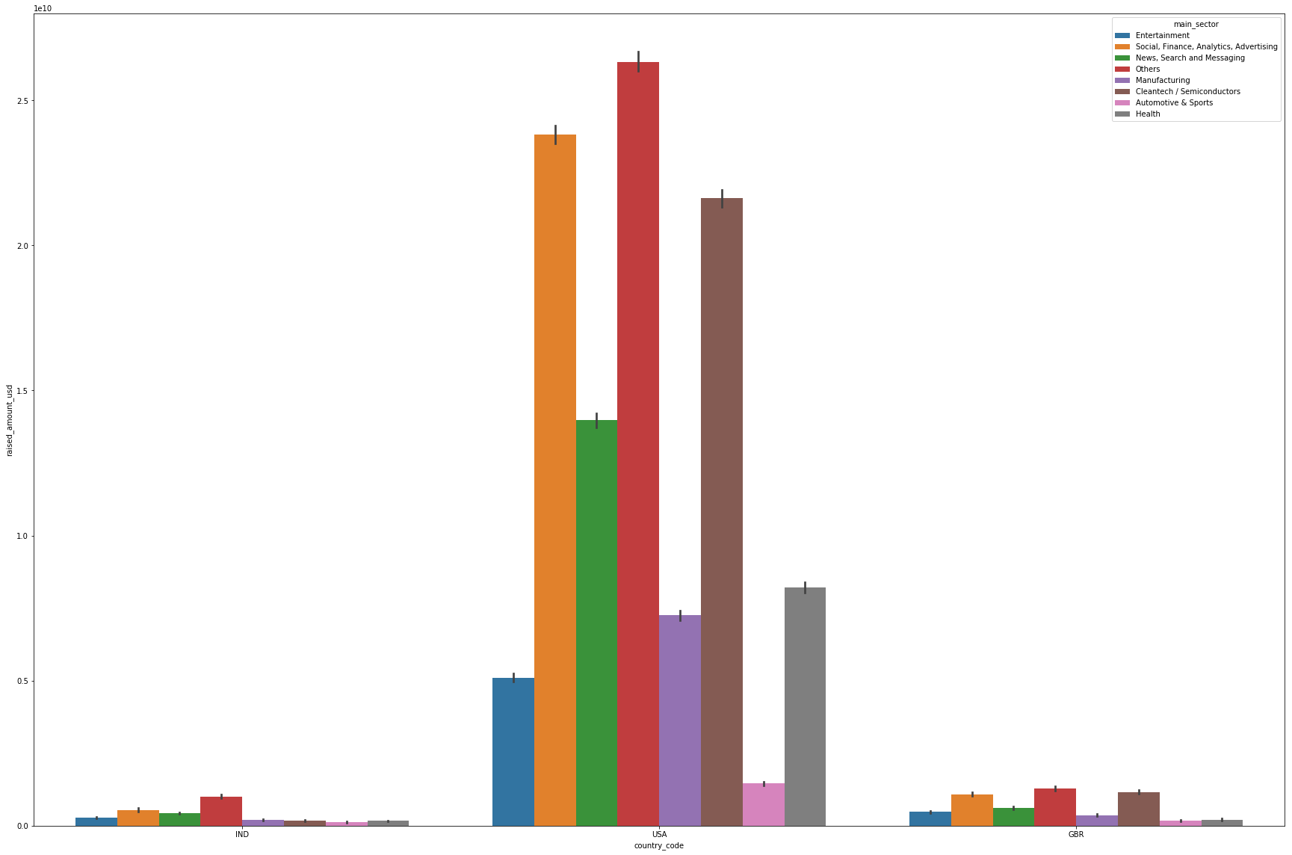
Investments across top 3 countries

Slide 8
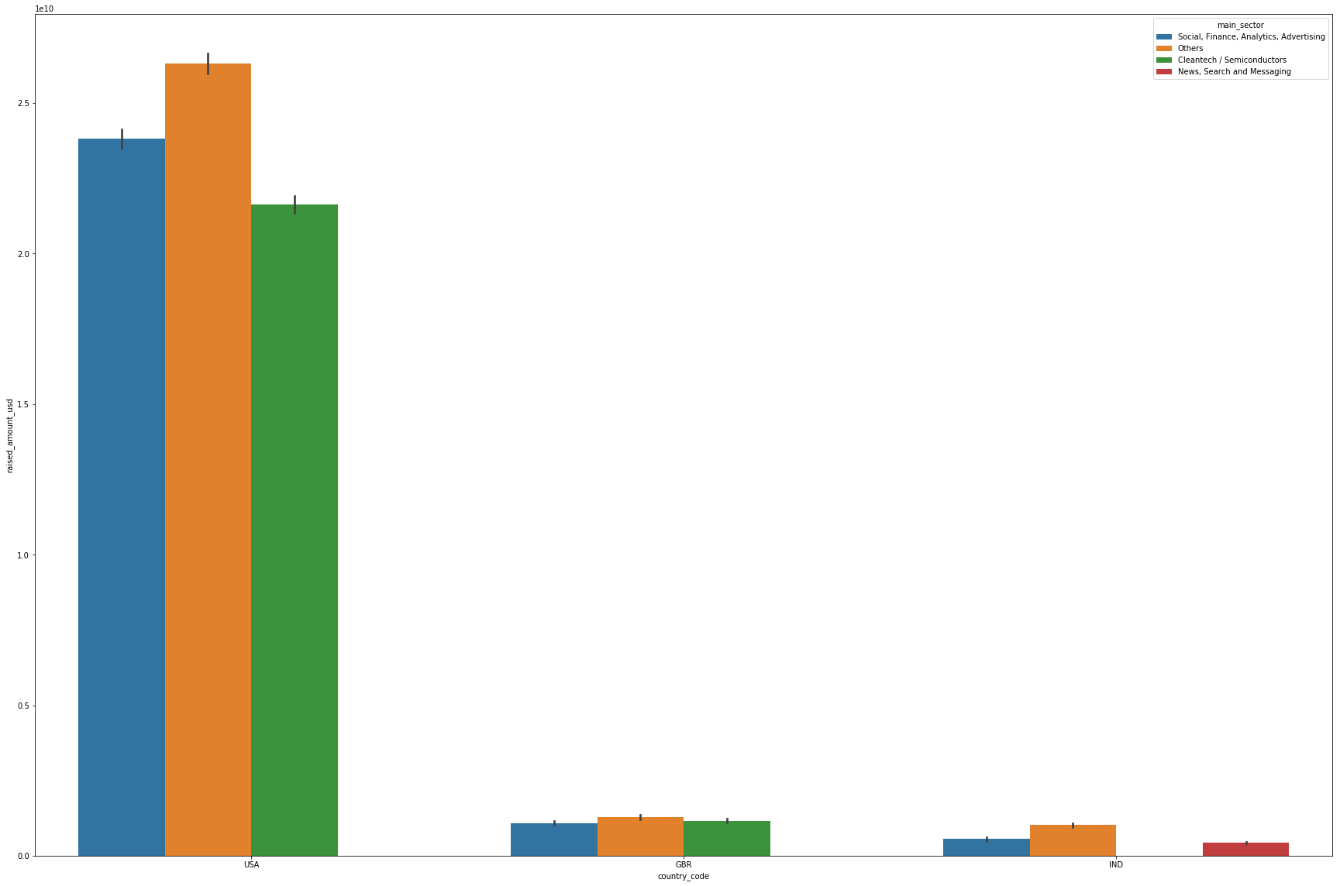
Investments across top 3 sectors of the top 3 countries

Slide 9
Where to Invest
From the Plots, USA is market leader attracting both Investments and Investors, followed by United Kingdom and India
Investment Strategy
USA - 50% - spread across top companies across top 2 sectors
Virtustream
Capella
shotspotter
demandbase
GBR - 30% - spread across top company in top 2 sectors
electric-cloud
celltick technologies
IND - 20% - spread across top company in top 2 sectors
first-cry-com
manthan-systems

